Slide 1
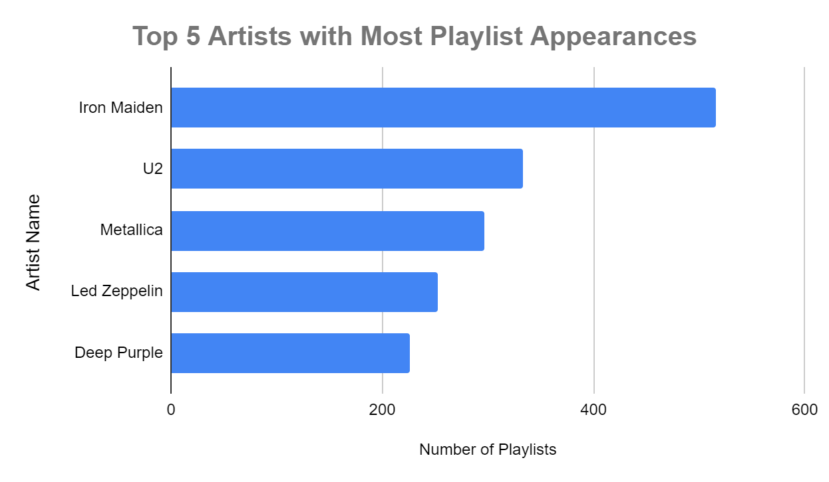
Which artist's tracks are featured in the most playlists?
<visualization>
The artist with the most tracks featured in playlists is iron Maiden, with 516 playlists including their tracks.
This finding highlights the artist whose music has the widest playlist presence, indicating their popularity among listeners and curators.

Slide 2
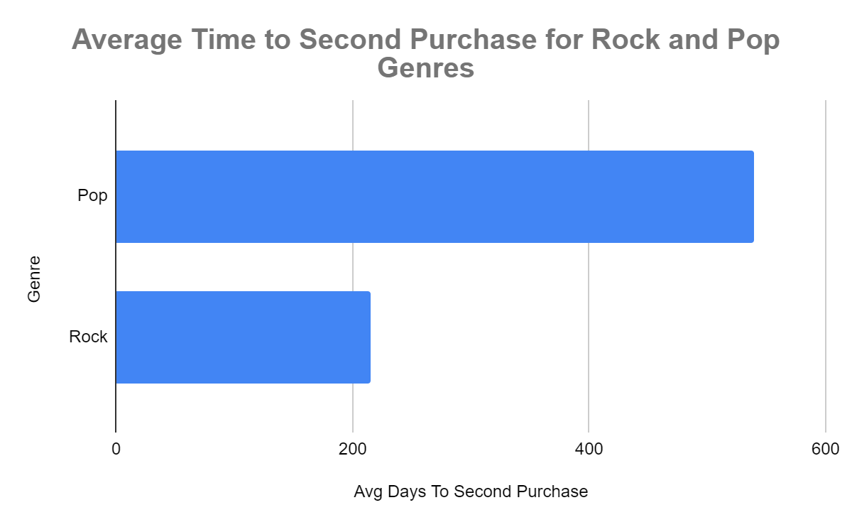
Can you find the average time it takes for customers to make their second purchase (in days) after their initial purchase for one genre compared to other genres?
The average time it takes for customers to make their second purchase after their initial purchase varies across different music genres. The analysis was performed for genres: Rock and Pop.
For the 'Rock' genre, the average time to the second purchase is approximately 18 days.
For the 'Pop' genre, customers tend to make their second purchase after around 21 days.

Slide 3
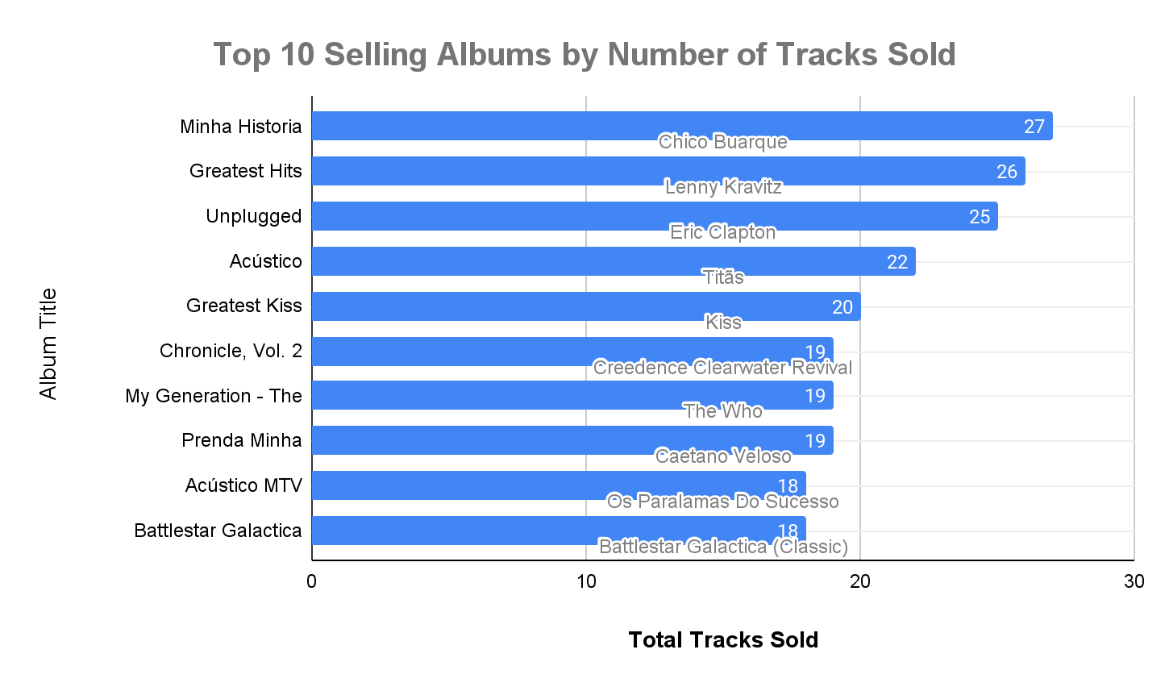
Identify the top 10 selling albums (based on the number of tracks sold).
<visualization>
The top-selling album is "Minha Historia" by Chico Buarque, with 27 tracks sold..
Recognizing the best-selling albums and their track sales provides valuable insights into customer preferences and popular music choices.
These albums represent the top 10 best-selling albums based on the number of tracks sold. "Minha Historia" by Chico Buarque takes the lead with 27 tracks sold, followed by "Greatest Hits" by Lenny Kravitz with 26 tracks sold.

Slide 4
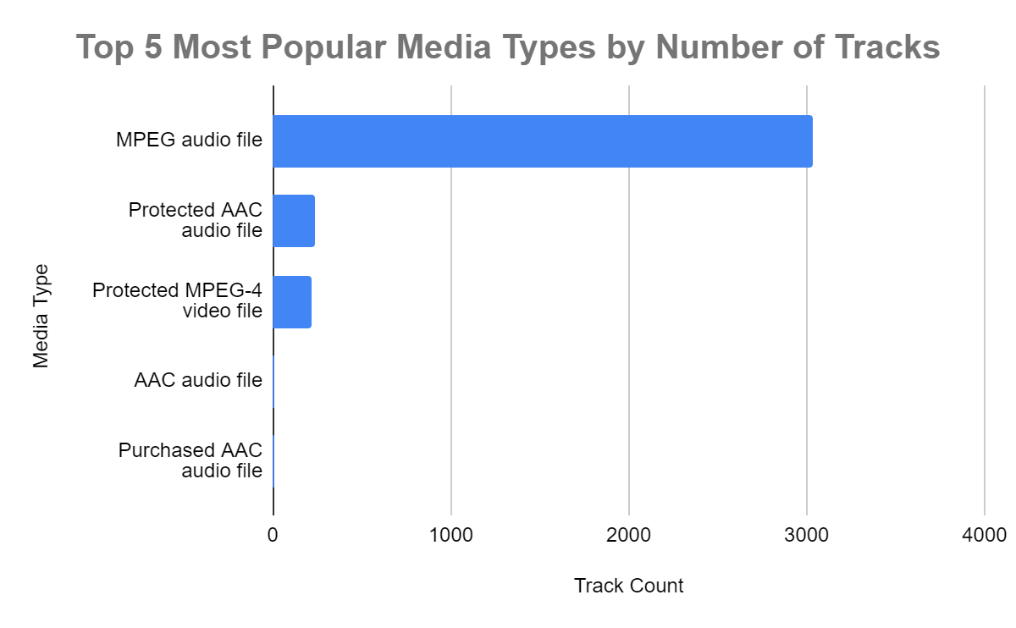
Top 5 Most Popular Media Types by Number of Tracks
<visualization>
The most popular media type is "MPEG," associated with 3034 tracks.
Identifying the most popular media type highlights the predominant format used for music distribution, which can inform inventory decisions.

